Slide 1
Molecular Dynamics Simulations on a GPU in OpenCL
Alex Cappiello

Slide 2
Background
How do a group of molecules interact with one another?
Useful for determining thermodynamic properties.
  Can be advantageous over carrying out an experiment to measure.
Simulation is broken into two steps based on Newton’s Laws of Motion.
  Find the forces exerted on each particle (hard).
  Use the forces to update position (easy).

Slide 3
What’s So Interesting?
A tradeoff between time and accuracy.
  Low accuracy limits scientific usefulness.
Timestep on the order of femtoseconds (10⁻¹⁵ s) or smaller to be meaningful.
Small inputs are also not meaningful.
Past work mostly done using MPI & friends on clusters. Less on GPUs.
  However, there’s lots of independent parallelism on the table and MPI has to worry about communication.

Slide 4

Approach
Perform the calculations with OpenCL kernels and render with OpenGL.
Use OpenCL-OpenGL interoperability to eliminate CPU-GPU memory transfer.
Naïve solution: for each particle, loop over all other particles and the force between them.
Can we ignore particles beyond a certain distance (F ≈ 0)?
  Divergence.
http://www.dyn-lab.com/articles/cl-gl.html

Slide 5
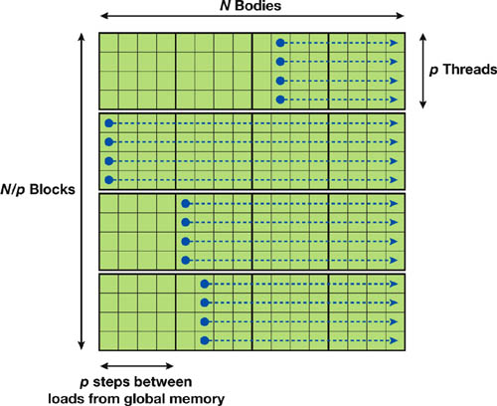
A Tile Decomposition
Still doing the same amount of work.
An OpenCL local group (think CUDA block) handles each of these N/p blocks.
Use memory locality to our advantage—load the tile’s particle positions into __local memory (__shared__ in CUDA terms).
How big should a block be?
Image credit: NVIDIA

Slide 6
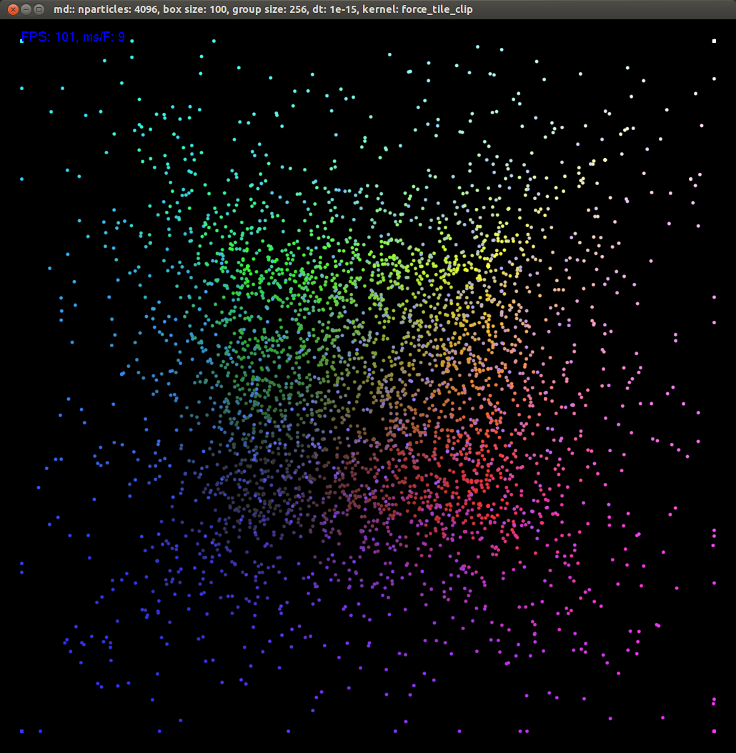
Embedded video removed. See http://youtu.be/AEdJNC2CgSE.

Slide 7
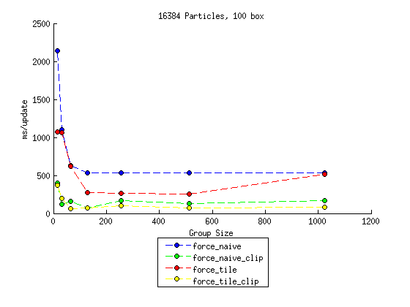

Slide 8
Conclusions
Despite divergence, ignoring long distance interactions made a much bigger difference than the tiling method.
  The opposite of my expectations.
  Would likely be amplified by a more complex force calculation.
  Tiling marginally better than naïve method.
No clear ideal size for the local group.
  Should be at least 64 (double the natural SIMD width).
  Larger groups (512 and 1024) generally not as good.
Although I didn’t measure the benefit of OpenCL-OpenGL interoperability, it was definitely a huge potential bottleneck avoided.

